Slide 1

ChatXRay:
A Multimodal Assistant for Chest Radiographs Summarization
Presenter: Gefei Gu (顾格非)

Slide 2




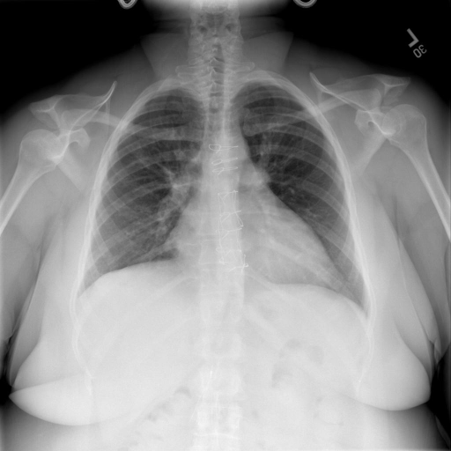
Background
Limited Doctors VS Numerous Patients
Lack of Professional knowledge

Slide 3
Related Works
Biomedical Chatbots
ChatDoctor
Med-Alpaca
PMC-LLaMA
DoctorGLM
Multimodel Medical Chatbots
XrayGPT
XrayGLM
LLaVA-Med
MultiModal Large Language Models
LLaVA/LLaVA-1.5, MiniGPT-4
Fuyu-8B、Qwen-VL, Visual-GLM

Slide 4
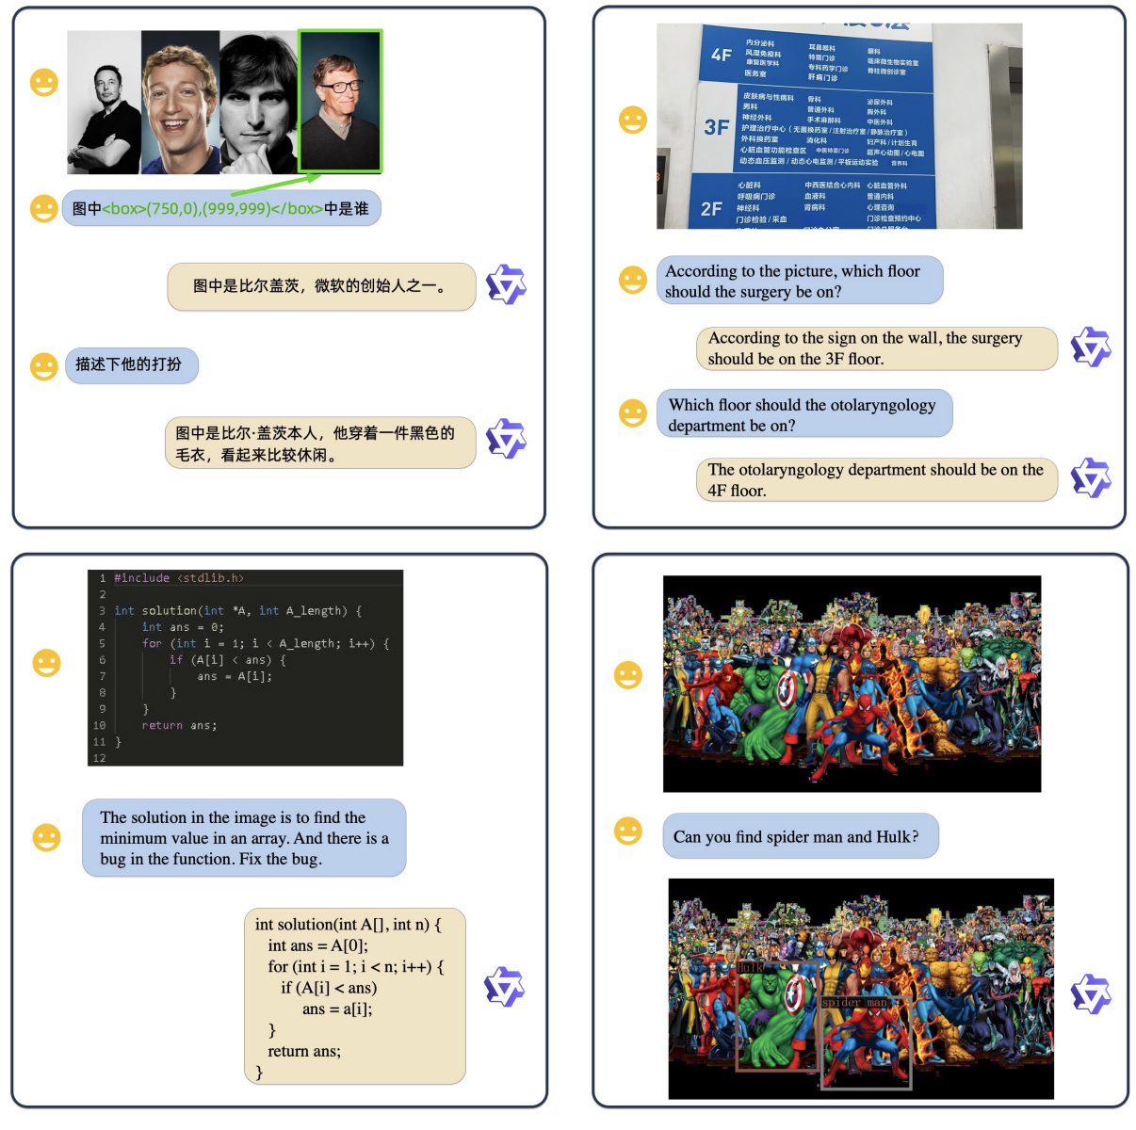
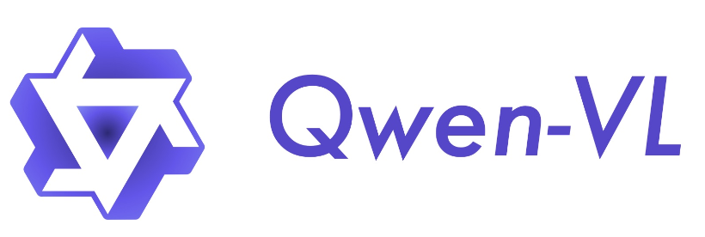
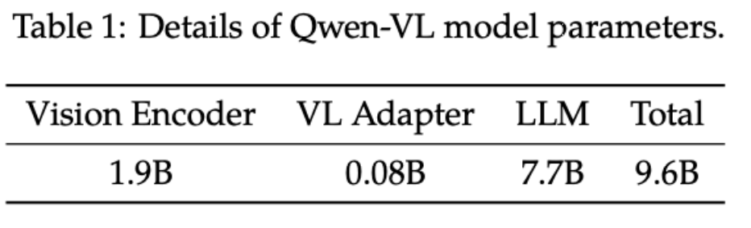
Method
Base Model:
A large-scale vision-language model designed to perceive and understand both texts and images

Slide 5
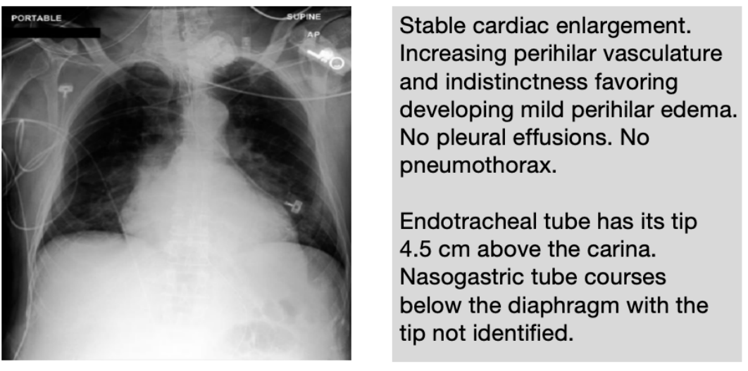
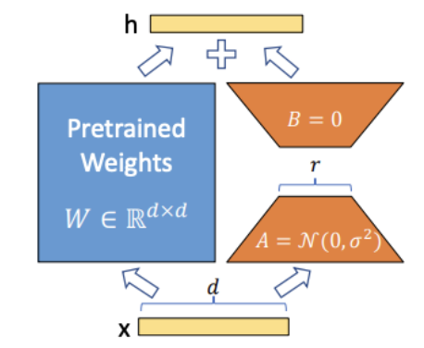
Method
Finetune Dataset Construction：
80000+ radiograph & report pairs
LoRA Technique
Example of a radiograph & doctor’s report pair

Slide 6
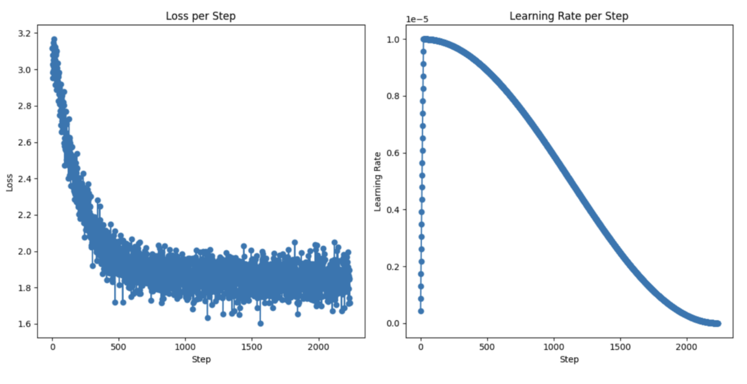
Method
Trained on Nvidia A100 80G for 27hours (1 epoch)
Visualization of Training Loss & Learning Rate

Slide 7


Demo
Radiograph
Patients
ChatXRay

Slide 8
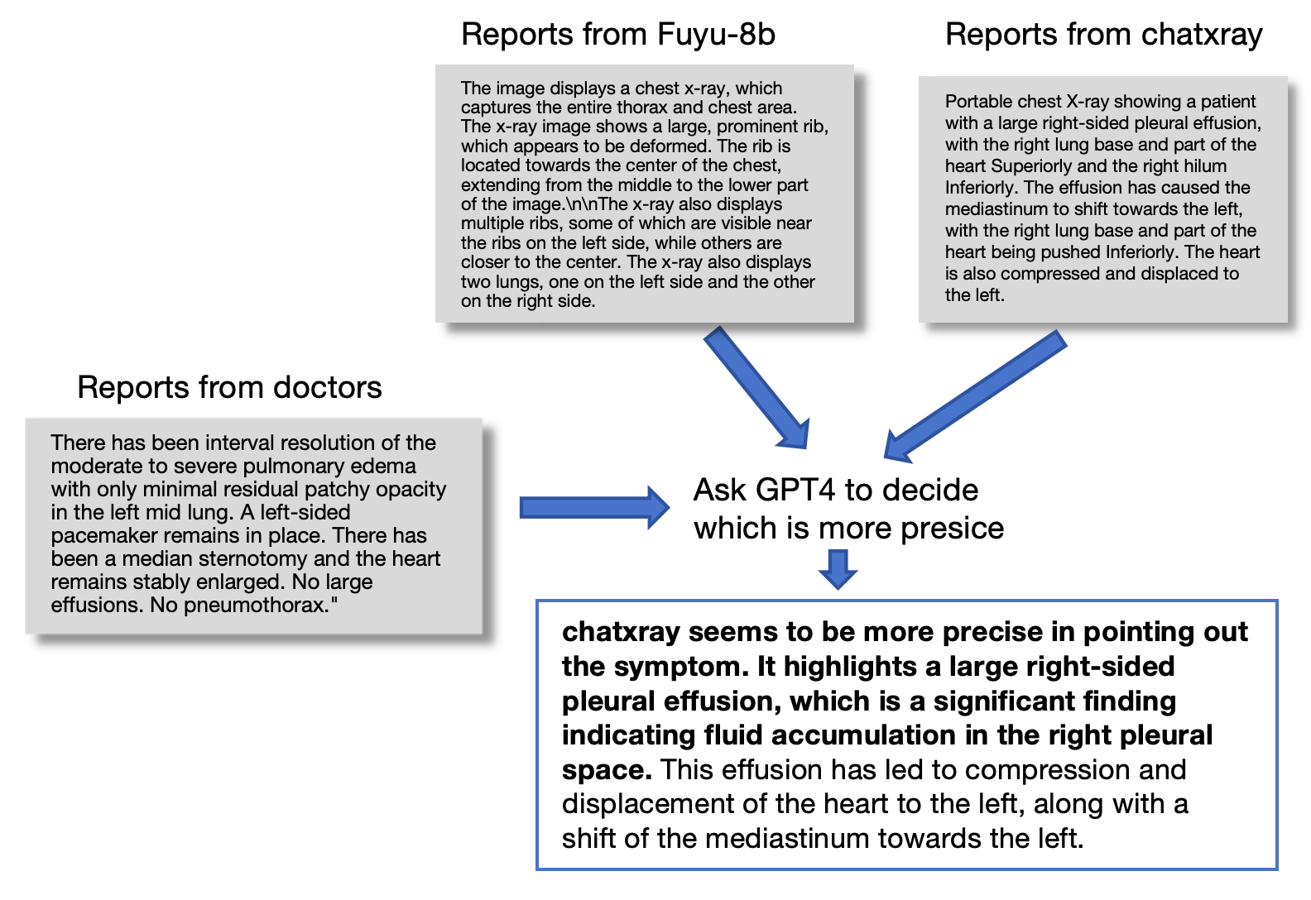
Experiments
Evaulation Pipeline

Slide 9
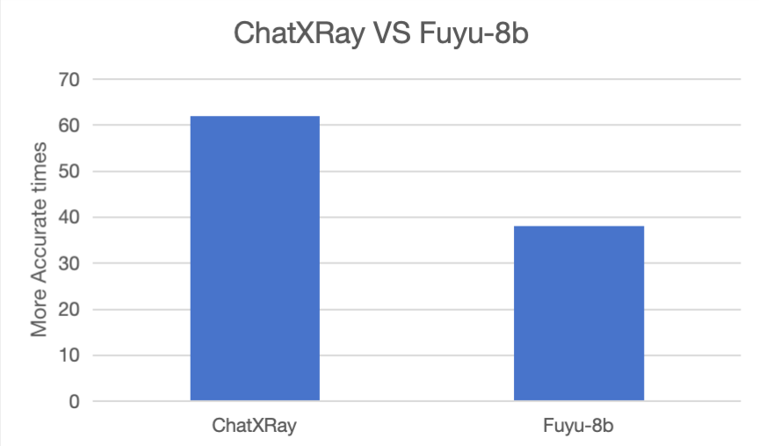
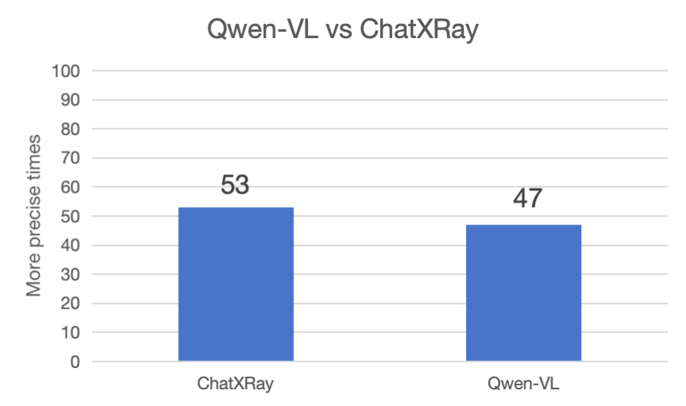
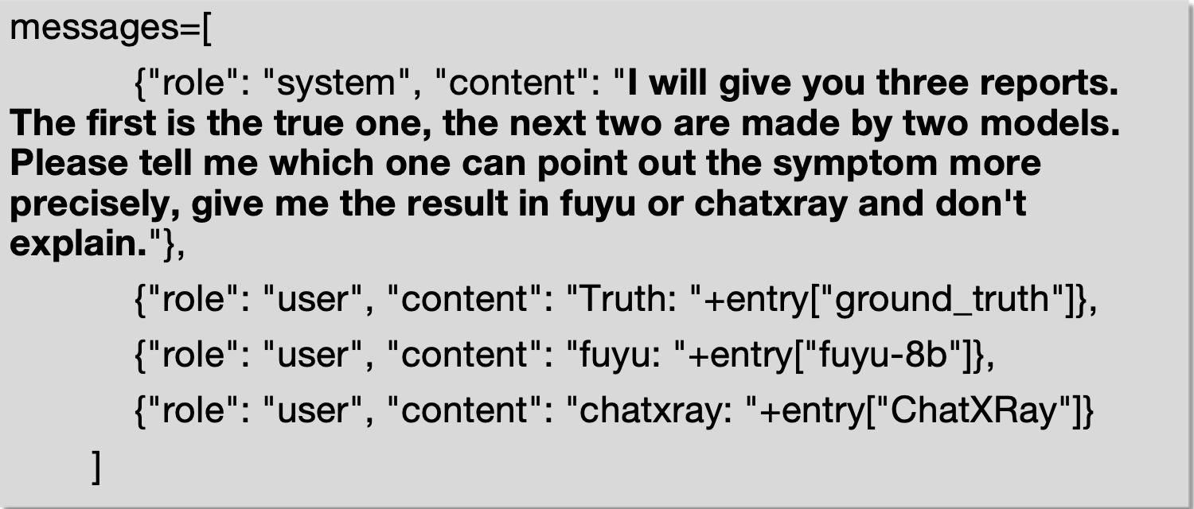
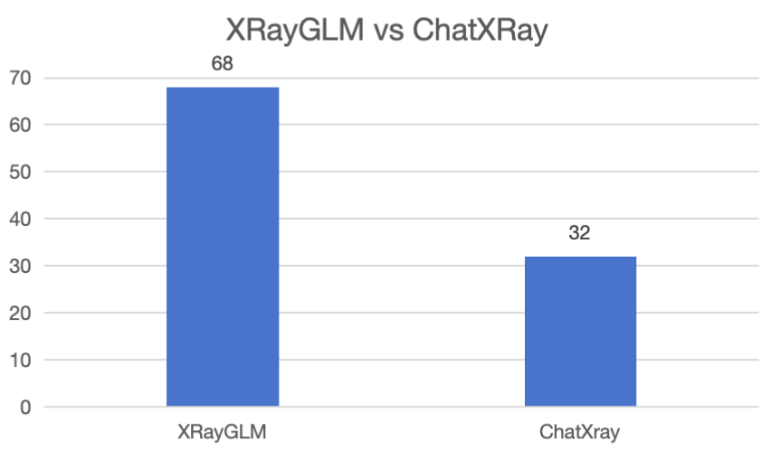
Experiments
GPT4 Prompt

Slide 10
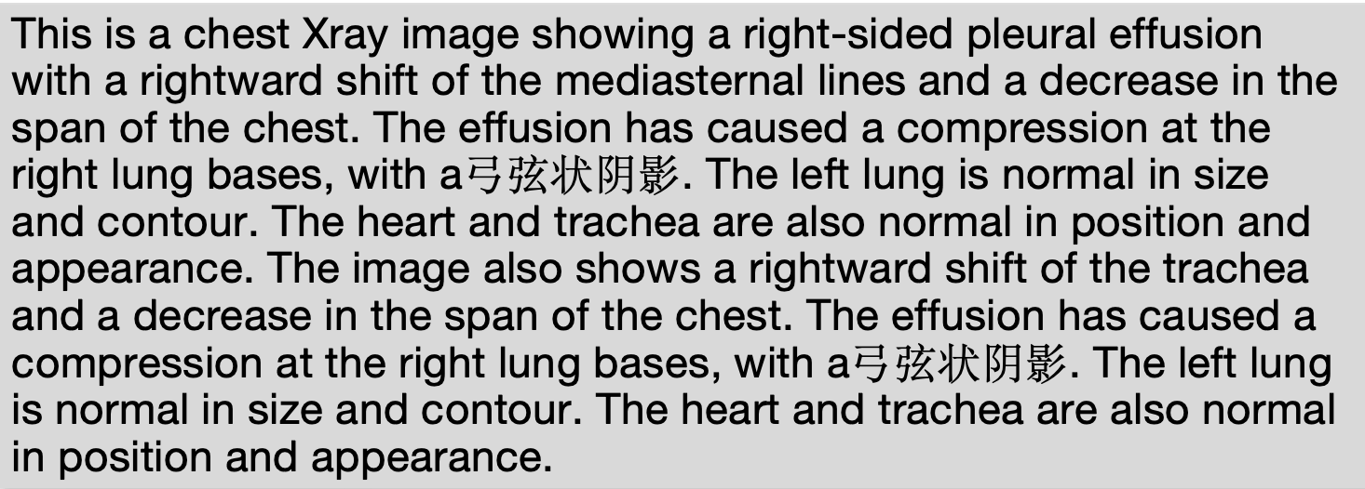
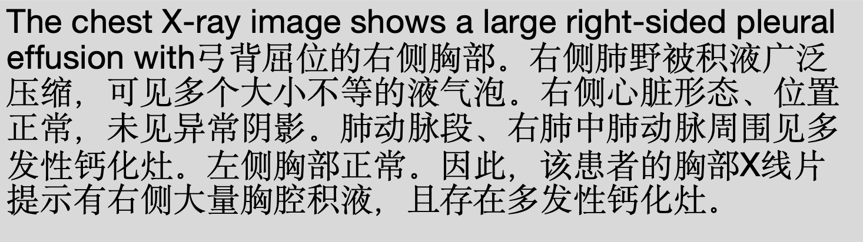
Discussion
Chinese Character Problem:
Maybe because QwenLM’s pretraining data contains a lot amount of chinese corpus.

Slide 11
Conclusion
we presented ChatXRay, a novel multimodel medical vision-language model that combines both modalities to analyze and give reports about chest radiographs.
We collected large number of expert labeled data from public datasets, and use lora techniques to finetune the powerful vision-language model (Qwen_VL) to build ChatXRay.
We conducted experiments to compare its performence with other models, and discuss the results.

Slide 12
Thanks for listening!

